Slide 1
Spring Boot

Slide 2
Spring Boot
Spring Boot makes it easy to create stand-alone, production-grade Spring based Applications that you can "just run“
Create stand-alone Spring applications
Embed Tomcat, Jetty or Undertow directly (no need to deploy WAR files)
Automatically configure Spring and 3rd party libraries whenever possible
Absolutely no code generation and no requirement for XML configuration

Slide 3
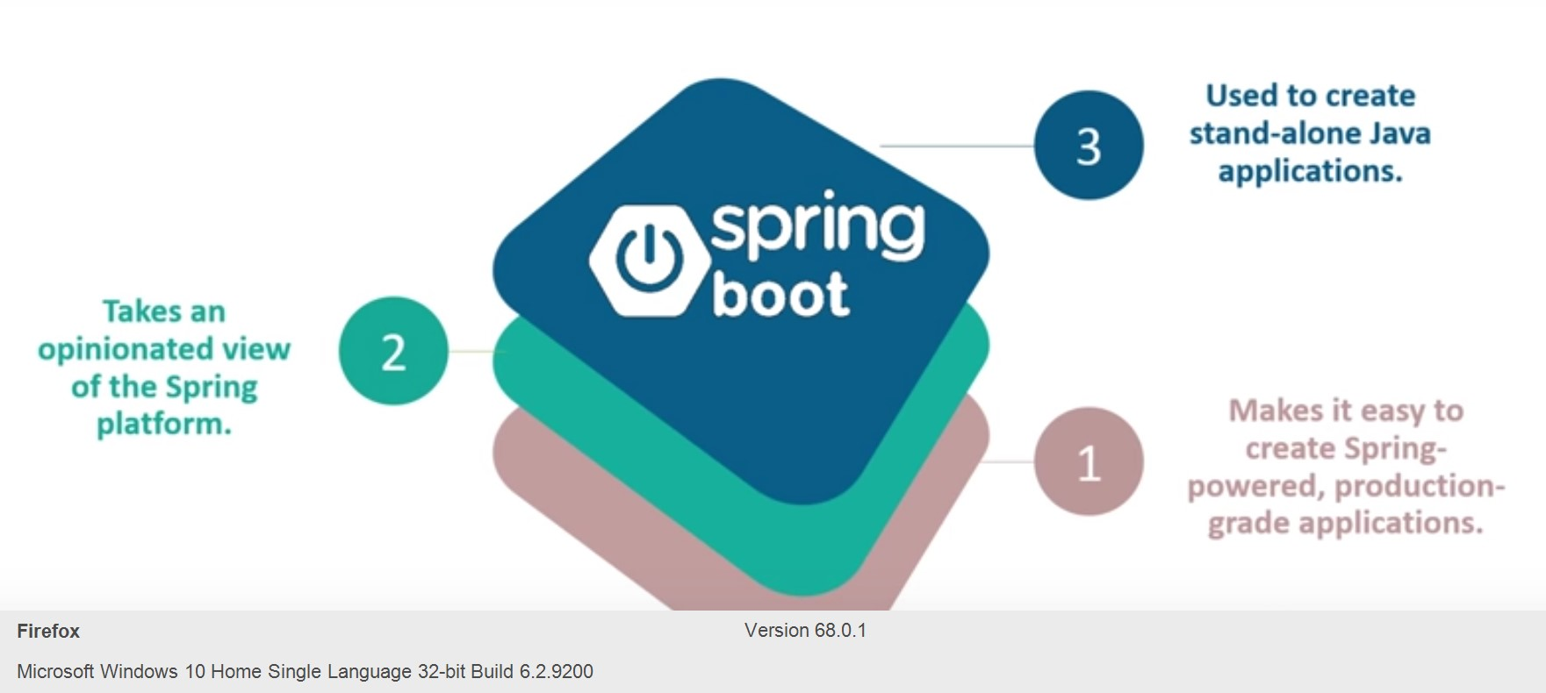
Spring Boot

Slide 4
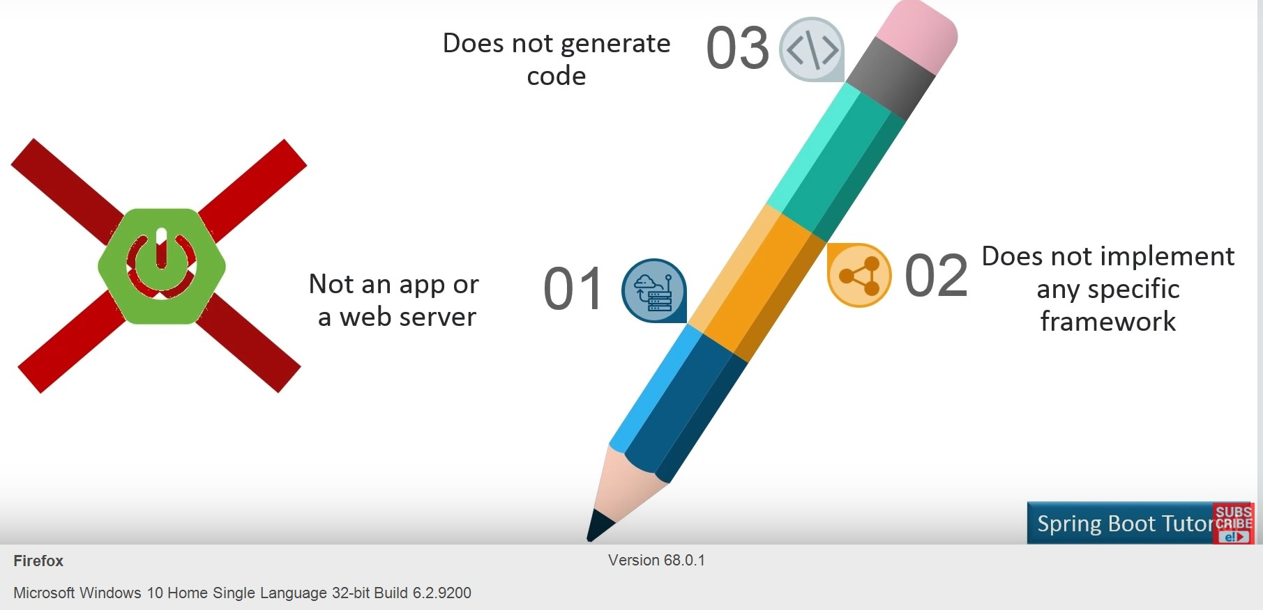
Spring Boot is not

Slide 5
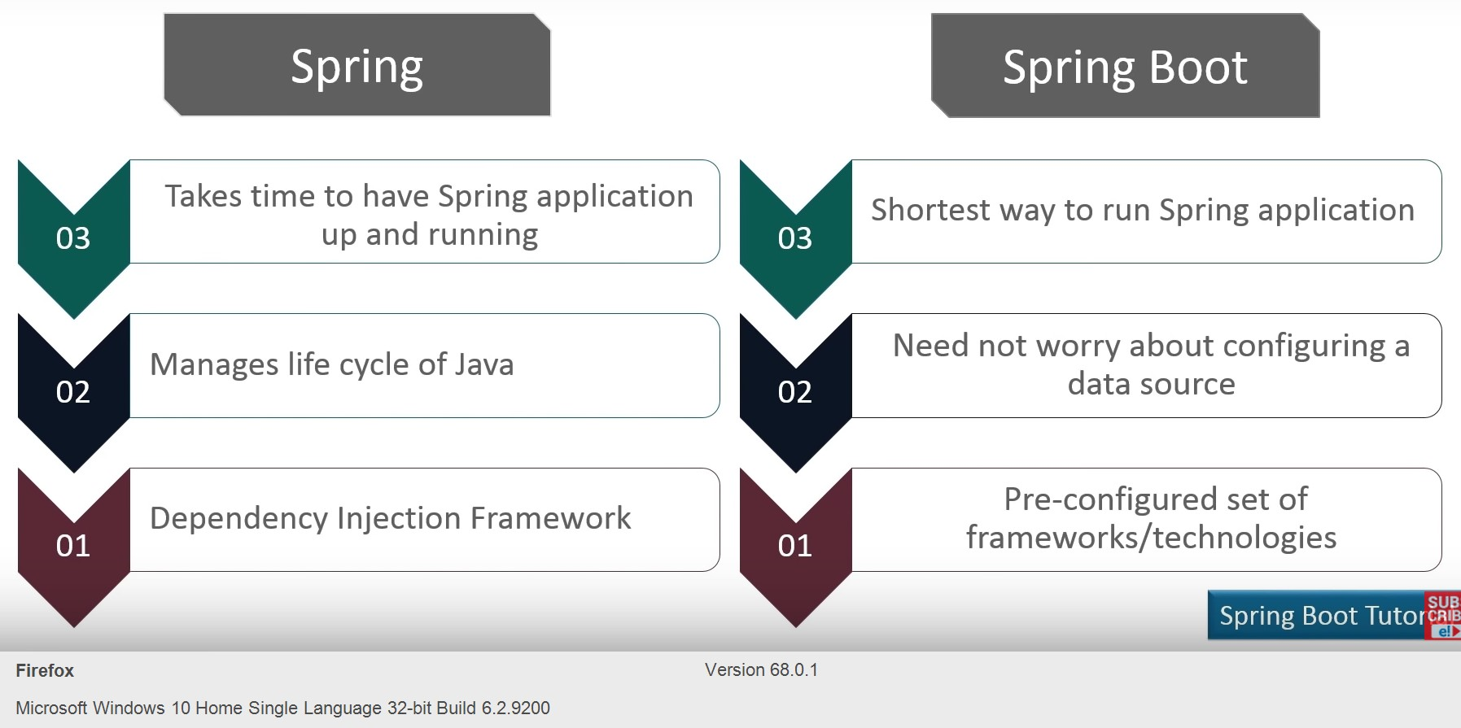
Spring vs Spring Boot

Slide 6
Spring Boot Advantages
Create stand-alone Spring applications that can be started using java -jar.
Embed Tomcat, Jetty or Undertow directly. You don't need to deploy WAR files.
It provides opinionated 'starter' POMs to simplify your Maven configuration.
It automatically configure Spring whenever possible.
It provides production-ready features such as metrics, health checks and externalized configuration.
Absolutely no code generation and no requirement for XML configuration.

Slide 7
Spring Boot Web
Provides embedded tomcat server
Web application can be bundled as normal application with main method
No DispatcherServlet configuration required
Configuration can be provided through properties

Slide 8
application.properties
Used to provide configuration
Full list of properties at --
https://docs.spring.io/spring-boot/docs/current/reference/html/common-application-properties.html
Example
environments.dev.url=https://dev.example.com environments.dev.name=Developer Setup environments.prod.url=https://another.example.com environments.prod.name=My Cool App

Slide 9
application.yml
YAML is a superset of JSON, and as such is a very convenient format for specifying hierarchical configuration data
Example
environments:
dev:
url: https://dev.example.com
name: Developer Setup
prod:
url: https://another.example.com
name: My Cool App

Slide 10
properties OR yaml
We can use either properties file or yml file.
Try not to use both in the same application
If both properties and yml files are available, property defined in properties file will have precedence

Slide 11
Spring Boot JPA
Automatic CRUD Repository for entities
CrudRepository interface provides basic methods
JPARepository interface provides additional JPA related methods
DB configuration through properties file or YML file
In memory database H2

Slide 12
H2 in-memory database
H2 is in-memory database
Need H2 dependency
H2 console can be used by setting following properties
spring.h2.console.enabled=true
spring.datasource.url=jdbc:h2:mem:testdb
spring.data.jpa.repositories.bootstrap-mode=default

Slide 13
CrudRepository
long | count() Returns the number of entities available.
void | delete(T entity) Deletes a given entity.
void | deleteAll(Iterable<? extends T> entities) Deletes the given entities.
void | deleteById(ID id) Deletes the entity with the given id.
boolean | existsById(ID id) Returns whether an entity with the given id exists.
Iterable<T> | findAll() Returns all instances of the type.
Iterable<T> | findAllById(Iterable<ID> ids) Returns all instances of the type T with the given IDs.
 | …….. More methods

Slide 14
Spring Boot JPA properties
spring.datasource.url= jdbc:mysql://localhost/ramana
spring.datasource.username=root
spring.datasource.password= rasaspsi
spring.datasource.driver-class-name= com.mysql.jdbc.Driver
spring. Jpa.hibernate.ddl-auto= create-drop

Slide 15
CrudRepository - Example
Extend CrudRepository and add additional methods if needed
@Repository
public interface StudentRepository extends CrudRepository<Student, Long>
{
public List<Student> findById(long id);
@Query("select s from Student s where s.age <= ?1")
public List<Student> findByAgeLessThanEqual (long age);
}

Slide 16
Using CrudRepository
CrudRepository can be autowired in a service or DAO class
@Autowired
private StudentRepository studentRepository;

Slide 17
JPA config annotations
If the entities are not in the base package, we may have to provide @EntityScan annoation to scan for entities
@EntityScan(basePackages = “com.boot.examples.entity")
If the Repositories are not in the base package, we may have to provide @EnabelJpaRepositories annoation to scan for Repositories
@EnableJpaRepositories(basePackages = “com.boot.jpa.repo")

Slide 18
Creating Spring Boot Application
Through Spring Initializr
As a maven project
Using Gradle
As a starter project in STS

